Slide 1






Unprecedented Code Change Automation: The Fusion of LLMs and Transformation by Example
Malinda Dilhara
Abhiram Bellur
Timofey Bryksin
Danny Dig
Notes:
This talk is about the fusion of LLMs with code transformation systems, to perform an unprecedented amount of transformations correctly and safely.
This is my team: Malinda, my advisor Danny Dig, and Timofey from JetBrains.
Again, please pay attention to how I am modeling for you a paper presentation. You all read the paper so I will not present everything in the paper. Instead, I will present supplemental information that will help us understand the bigger context of the problem being solved. In particular, I will present how this current paper fits in the bigger narrative that these authors were doing with 2 other research papers.

Slide 2
Motivation
Developers repeat code changes
Repeated changes happen because:
Adoption of shared coding idioms
Adherence to common best practices
Tackle similar programming challenges
Fixing bugs, API updates, Language upgrades
Notes:
Most Software development is not so much writing brand new code, but it is about changing existing code: enhancements, bug fixes, software upgrades;
During these tasks, developers often repeat code changes.
Sometimes, they aim to adopt same code idioms, while at other times, they need to adhere to same best practices.
Additionally, developers find themselves fixing identical bugs and implementing the same API updates and language upgrades.
Due to these shared reasons, developers frequently encounter the need to repeat the same code changes.

Slide 3

Code change pattern (CPAT)
number = 0 for x in int_list: number = number + x
number = numpy.sum(int_list)
Commit c8b28432 in GitHub project NifTK/NiftyNet
Notes:
Here’s an example ……
In this code change performed in a project, the developer transforms their for loop-based sum computation to `np.sum`. This is considered to be more performant than using inefficient Python language constructs, as the numpy library is highly optimized and uses vectorization under the hood.
This change has occurred in many other commits within the same repository and in other repositories.
Hence, this is considered a pattern, and we called it code change pattern we abbreviated it as CPAT.
In our previous work we observed 30,000 of code change on analysis X number of projects. This number would surely increase as we increase the scope of analysis

Slide 4

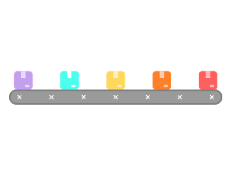

Overview of Transformation by Example (TBE)
Improved Project
Example changes
Infer transformation rules, apply transformations [ICSE’23]
Mine examples [ICSE’22]
Notes:
Transformation by example systems are the solution to automate CPATs.
We abbreviated as TBE systems,
work by mining change-information from repository commits. rich exemplars, from which you gettransformations rules
Then, they infer transformation rules, which are applied in new sites.
There are many TBE systems, ex: APIFix, TCInfer, PyEvolve.
This approach offers an alternative to how IDEs typically automate code changes, where each change is hardcoded. TBE uses a data-driven approach,
learning from actual code changes and applying the changes to other target codes without explicit hardcoding.
The challenge for these systems is syntactic variability.
To help developers in identifying and automating repeated changes, over the last few years, we developed an end-to-end pipeline.
This pipeline first consist with the tool, Change Miner, which has the ability to automatically identify repeated code changes that need to be automated, we published this in ICSE-2022.
Then we developed PyEvolve it is in the other end of the pipeline, it takes the code changes as input, and then help developers to automatically apply the code changes. We published this work in ICSE-2023.
PyEvolve is a program-by-example system, that means it takes code changes as input and then infers transformation rules that we can use to apply the code changes to other places.
Say: this an alternative to how IDEs typically do things, and this data driven approach where we learn from project histories.
This approach offers an alternative to how IDEs typically automate code changes, where each change is hardcoded. Our technique employsdriven approach,
learning from actual code changes and applying the changes to other target codes without explicit hardcoding.

Slide 5
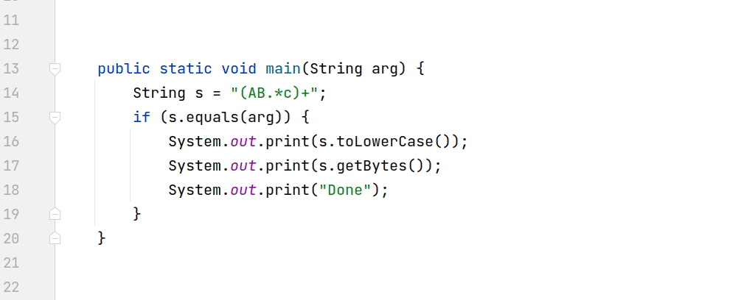
There are many other Transformation by Example(TBE) systems
PyEvolve (ICSE-2023)
PyEvolve is a TBE system
Code example
- new SqlScriptExecutor("foo",() => true , null) + new SqlScriptExecutor("foo",() => true, null, () => Substitute.For<IJournal>())
new SqlScriptExecutor(𝑋1,𝑋2,𝑋3)
Transformation Rule
→
→
new SqlScriptExecutor(𝑋1,𝑋2,𝑋3, () => Substitute.For<IJournal>())
APIFix - Gao et al. (OOPSLA - 2021)
TCInfer – Ketkar et al. (ICSE-2022) collaboration ML4SE @ JetBrains Research
Notes:
PyEvolve is not the only one that use the technique transformation by example system.
It is a technique that tool builders have been using to build code automation tools.
APIFix is one such tool that developers can use to migrate Android APIs.
It takes a code change as input, as shown in this slide, and generates a rule that can be applied to other codebases to make similar code transformations to the example change.
TCInfer is another such tool developed by our research group to migrate types in Java code.
This approach offers an alternative to how IDEs typically automate code changes, where each change is hardcoded. TBE uses a data-driven approach,
learning from actual code changes and applying the changes to other target codes without explicit hardcoding.

Slide 6
Different syntactic variants are challenging
number = 0 for x in int_list: number= number + x
number= np.sum(int_list)
count = 0
for i in range(len(int_list)):
count += int_list[i]
Notes:
However, TBE systems require a lot of different examples of generate good transformation rules.
And it is difficult to find a wide variety of examples in open source projects.
As a result, transforming semantically equivalent, but syntactically different code blocks is a challenge for TBE systems.
Let me illustrate this with an example: Let’s say we want to apply this transformation rule to the code site at the bottom.
The code on the bottom is equivalent to the code on top,
however it iterates through a list similarly to the original code change to compute a sum. Instead of directly iterating the list, it uses the len and range functions to access the list using list indexes.
Existing TBE systems would overlook this target code because they are not aware of the different syntactic variability in the code change.

Slide 7
Different syntactic variants are challenging
count = 0
¡= 0
while i < len (int_list):
count += int_list[i]
i++
result = 0
for i in range(len(int_list)):
result = result + int_list[i]
count = 0
for i in range(len(int_list)):
count += int_list
result = 0
for index, value in enumerate(int list):
result = result + value
result = 0
for index, value in enumerate (int_list):
result += value
Notes:
<Add animation one-by one>
This is not the only semantically equivalent but syntactically different target code,
there can be many other ways that that developers iterate over list to compute sum of elements,
Some target code can use the enumerate function, a while loop, and even list indexing or direct iteration.
There may be many more syntactic variants due to the combinations of ways developers can write the same code with different syntax.
In our study, we found over 50 different ways to write this same for loop.
Identifying these variants is essential to increase the number of transformations that existing transformation-by-example systems can perform.

Slide 8
Key Idea
LLMs’ training data comprises of various ways that developers write the same piece of code.
Use LLMs to generate different variations of the input code
LLM
Input CPAT
CPAT Variants
Infer transformation rules, apply transformations
Notes:
Automating the syntactic variants was not feasible until the emergence of large language models.
Large Language Models (LLMs) are pre-trained on extensive datasets of source code. If we can harness the power of LLMs’ to produce semantically equivalent, yet previously
unseen syntactic variants of the original CPAT, we can significantly increase the effectiveness of TBE systems.
So the key idea in our approach is to use Large Language Models to generate syntactic variants and then infer transformation rules to automate them.
By utilizing this approach, we can automate all 40 variants by looking at one single change.

Slide 9

LLMs Hallucinate
number = 0 for x in intArray: number= number + x
number= np.sum(intArray)
Original CPAT
count = 0
for i in range(len(int_list)):
count += 5
Incorrect
count = 0
for i in sorted(int_list):
count += i
Unrealistic
Not applicable
count = sum(int_list)
Notes:
LLM are great at generating variants. However, they hallucinate.
We identified mainly three types of hallucination that LLMs exhibit.
The first type of hallucination involves incorrect suggestions.
In this example, the code adds the value five to the accumulator variable, which is not semantically equivalent to the input code change.
<Click>
LLMs also produce unrealistic variants. In this second example, it sorts the list before iterating, a practice that is not typically done by real-world developers.
If we have too many unrealistic variants, TBE systems would spend additional time searching for them; eventually degrading its performance.
<Click>
The last is a minor kind of hallucination in which the variant deviates from the intent of the original code change.
In this particular code, the LLM suggests a variant using Python's sum function, which is semantically equivalent to the original change,
but it does not use loops to iterate over a list.
Therefore, this code is a deviation of the original intent of the input code change,
and may not be wise to automate.
<Click>
We need to identify these hallucinations and remove them, to safely use large language models to automate unseen variants.

Slide 10

LLM + Static Code Analysis + Dynamic Code Analysis
Notes:
So the idea is that LLM alone cannot be trusted, and we employ static code analysis and dynamic code analysis to further strengthen the validity of the variants that they produce.

Slide 11
Selecting correct Variants
count = 0
for i in range(len(int_list)):
count += 5
Generate Test Cases
Execute Test Cases Select Variants Semantically Equivalent to the CPAT
Variants
LLM
CPAT
Correct variants
Execute Test Cases
Validate Test Cases and Execute them against original CPAT
Valid Test Cases
Test cases
Notes:
To select correct variants that are semantically equivalent to the input code change, we employ test cases.
<Click>
We do not manually write them; instead, we use LLM itself to generate test cases that can be used to evaluate the semantic equivalence to the original code change.
<Click>
We check the validity of the test-case by running it against the original code
selecting passing tests.
<Click>
<Click>

Slide 12
Selecting Realistic Variants
count = 0
for i in sorted(int_list):
count += int_list[i]
Detecting all the unrealistic variants is hard
The goal is to reduce as many unrealistic variants as possible.
Fine-tune the randomness to generate fewer unrealistic variants
Notes:
Pruning unrealistic variants is hard:
ex sort before sum.
And, It is important to mention that there is no way to completely remove the unrealistic variants,
As they are semantically equivalent and pass all test cases
our target is to reduce them as much as possible.
We studied the generation of realistic variants along with the LLM hyperparameter - temperature,
and found that temperatures ranging from 0.5-0.7 produced the most amount of realistic variants.

Slide 13
Selecting Applicable Variants
count = sum(int_list)
Use static analysis-based rules to remove not applicable variants
1) Number of control nodes (e.g., For loops) are equal in both original CPAT and Variant?
2) Does the variants contain any new declarations (e.g., method declarations)
Notes:
The final step of the validation process is to select only the applicable variants that align with the main intent of the original code change.
To do this, we use multiple rules that we can statically check:
Two of such examples are,
1. We verify that the number of control nodes is equal on both sides.
2. We ensure that the variant does not include any new declarations.
We employ these rules to remove the non applicable variants.

Slide 14
Harnessing full power of LLMs
Fixed-point iteration (I_{f})
Prompt iteration (I_{p})
LLM
Validations based on Dynamic/Static code analysis
CPAT
Applicable Variants
PyCraft!
LLM
CPAT
Test cases
Notes:
We want to generate an exhaustive list of uneen variants that are applicable so that we can harness the power of the language model to its fullest potential.
To achieve this, we make two steps.
We first prompt LLM with code change patterns,
And then the output goes through the validation process.
<Click>
And then we re-prompt the same prompt multiple times to generate more variants.
We do this because,
The output OF LLMS can exhibit
variability when the LLM is presented with the same prompt multiple times.
This MAINLY because: (i) LLMs generate responses using a combination of learned patterns and random sampling,
it introduce
slight variations in answers each time due to the inherent randomness in the generation process;
And SECOND
(ii) LLMs can explore diverse solutions and improve their responses iteratively
Therefore we re-prmopt the same prompt multiple times to generate more variants.
<Click>
Then we also perform fixed-point iteration that mean we take output from previous iteration and feed it back to the LLM.
With this step we can generate an exhostive list of unseen variants for a given Code change pattern.
Of cource, we cannot re-prompt indefinitely. Instead, we study the number of times we have to re-prompt to get the most out of the language model in the evaluation section.
<Click>
To generate all possible test cases, we also perform prmpt iteration by repetatly prompting the same prompt.

Slide 15
Evaluation
RQ1) How effective are LLMs at generating variations?
RQ2) How effective are LLMs at generating test-cases?
RQ3) What are the optimal parameters for generating unseen variants?
RQ4) What are the optimal parameters for generating test cases?
RQ5) How effective is PyCraft at finding new opportunities and performing transformations over the previous state-of-the-art?
RQ6) How useful are the generated program transformations?
Notes:
We evaluate our ideas with six research questions.
The first and second research question tell us how creative and effective LLMs are
At generating variants and test cases.
The 3rd and 4th RQ aims to understand the optimal hyper-parameter value to employ LLMs with:
Namely, temperature(degree of randomness) and iterations(how many times to invoke)
The first research question is
How effective are LLMs at generating variations?
Under this we analyze the quality of the variants generated by LLMs
The second research question is How effective are LLMs at generating test-cases?
The fifth research question is used to study the impact of our tool compared to the baseline.
We observed that large language models (LLMs) produce many variants, but it is not worth to generate such a vast number of variants if actual developers do not like them. Therefore, under the last research question, we present the patches generated by variants to actual developers and report their responses.
Due to time contraints, we focus only first RQ and last two reseach questions in todays presentation. Hope that you’ll read the paper and find answers to other RQ.
Under this we analyze the quality of the test cases generated by LLMs
The third and fourth research questions are:
RQ3: What are the optimal parameters for generating unseen variants?
RQ4: What are the optimal parameters for generating test cases?
These questions were used to understand the variations in generating variants and test cases along with LLM parameters.

Slide 16
RQ1). How effective are LLMs at generating variations?
20 code change patterns
LLM
Variants
LLMs excel in generating unseen variants (584 per CPAT) but also produce errors (65%).
Notes:
We first selected 20 code change patterns
And we asked three different LLMs for this experiment, GPT3.5 GPT 4 and PALM to generate varaints.
For all input Code change patterns,
Gpt-3.5 generated on average 584 variants, and amongst them we saw 65% of them contains errors such as,
Type errors, import errors, formatting errors, syntax errors and also semantic mismatches.
This highlighst that LLM can not be used alone for automatng transformations, and we need further techniques enhance its reliability.

Slide 17

RQ5). How effective is PyCraft at finding new opportunities and performing transformations over the baseline?
20 Code change patterns
PyEvolve
PyCraft
200 GitHub Projects
X code transformations
14X code transformations
Notes:
The fifth research question is How effective is our tool vs the baseline TBE system Pyevolve..
To study the impact of our tools, we basically use 10 code change patterns and input them into both PyEvolve and PyCraft.
We use PyCraft as baseline, it is the best tranfomation by example system that can automate data and control flow variants but it is not aware of unseen syntaxes, like our tool PyCraft.
We use 200 highly-rated projects, such as TensorFlow, PyTorch, Keras, and Scikit Learn.
We observed that our tool performed 14 times more code transformations compared to its baseline.
Automating These variants would have been impossible without our tool.

Slide 18







RQ6). How useful are the generated program transformations?
“Well done, your changes are cleaner and either faster or equivalently faster”
86 Code change instances generated by variants
10 Code change patterns
PyCraft
“The changes look good, I am not sure why we didn’t write it that way before”
PyTorch
Keras
20 highly rated ML projects
Project: Ann-benchmarks
PyCraft generated 86 code patches, of which developers accepted 72 (83%)
Notes:
Even though our tool can automate many syntactic variants, they are useless if real developers would not accept them.
Therefore, under last reseach question, we study the usefulness of the patches generated by our tool to the real developers,
we selected 20 highly-rated projects such as TensorFlow and Keras and applied our tool to them. It generated 86 code changes, and we submitted all of them as patches to the projects.
We observed that 83% of them were accepted by the developers, and all of them was syntactic variants that were relevant to the original code change.
This shows that the changes produced by our tool is useful for the developers
VIP: I want to emphasize that, These are the best in class projects, despite that we were still able to identify opportunities for enhancements,
imagine how many opportunities we would have in average quality project

Slide 19


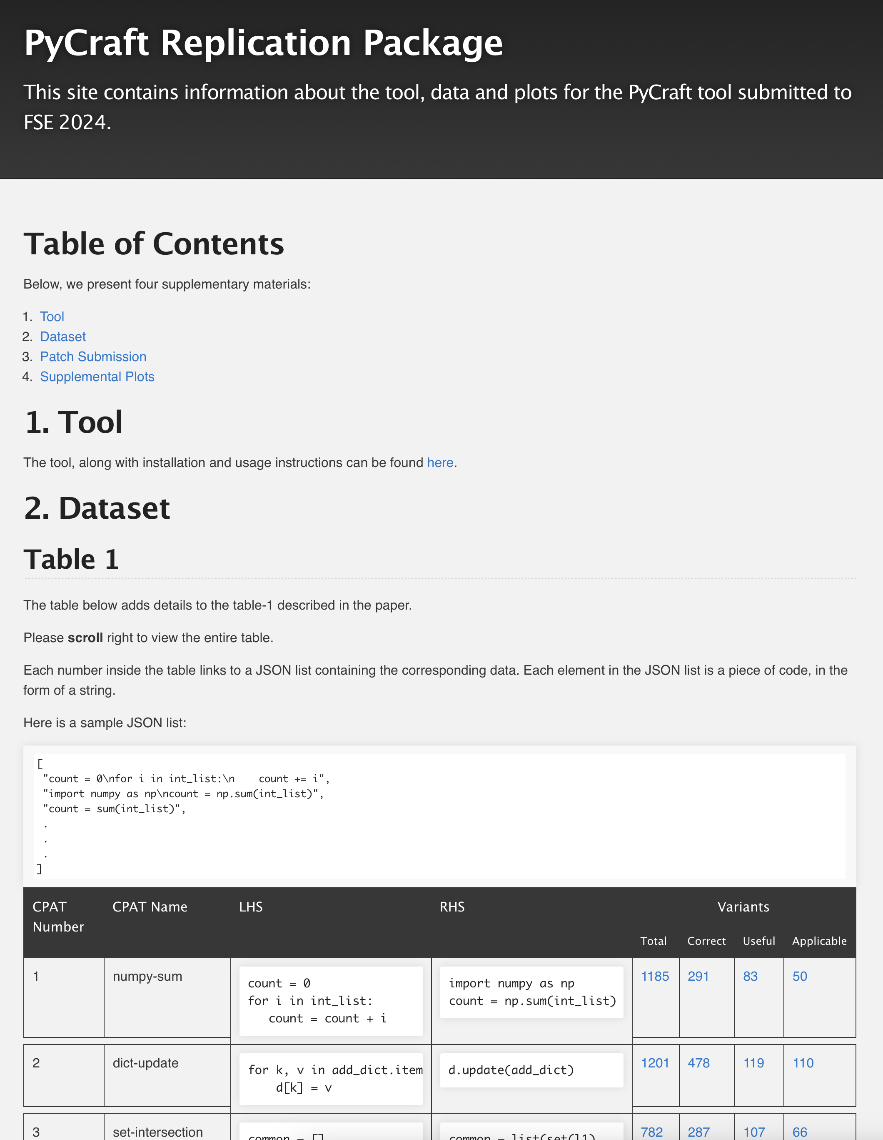
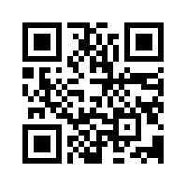
Summary
PyCraft is a novel transformation-by-example system that is 14x better than previous state-of-the-art.
Harness LLM power, to generate previously unseen variants (58 per CPAT)
Develop novel techniques to filter the high rate of LLM hallucinations
Discovered best-practices to get the most performance out of LLM
Submitted 86 patches to 20 open-source projects, of which developers accepted 72 (83%)
Dataset and Tool
How can you use our tool to your own research?
19
Notes:
Here's a summary of our work.
On the QR code, you'll find our tool and dataset.
Happy to take questions.
PyCraft performs 14x more code transformations compared to the baseline.
83% of the PyCraft changes were accepted by the developers.
We applied the tool to Python ML projects, but PyCraft is applicable to any domain in Python, technique is applicable to other programming languages

Slide 20
Generalizability, Robustness, and Future-Proofing
How does PyCraft ensure long-term robustness and adaptability?
How can it remain effective as underlying LLMs evolve, and can its hyperparameters be auto-tuned for new models?
How would its validation process adapt to languages with complex constraints like Rust's borrow checker?
How stable are the inferred rules across runs?
How critical are "unseen" variants to keeping pace with software evolution?

Slide 21
Integration into Developer Workflow & Real-World Application
How does PyCraft integrate into a real-world developer workflow, combining refactoring with new feature development?
How does it make context-aware decisions (e.g., CPU vs. GPU targets), support legacy system modernization?
How does it embody a nuanced refactoring philosophy that distinguishes between code needing abstraction and code that is intentionally verbose for clarity?

Slide 22
Evaluation, Metrics, and Limitations
Beyond immediate usefulness, how can the long-term impact on code maintainability be measured?
What is the system's false negative rate for good edits?
What are the primary limitations where the rule-mining breaks, such as with multi-location or non-behavior-preserving changes?
Crucially, how much of the performance uplift is attributable specifically to the LLM's generative diversity versus the underlying search and abstraction framework?

Slide 23
Security Considerations
What security considerations govern the use of "unseen" LLM-
generated variants for creating automated transformation rules?
What specific safeguards are in place to prevent the introduction of vulnerabilities or subtle bugs through these novel, unvetted code patterns?

Slide 24
Core Mechanism & Implementation
What is PyCraft's operational pipeline?
What complexity of Code Patterns and Transformations (CPATs)—from one-liners to larger blocks—can it handle?
How are its prompts programmatically architected from examples?
What search mechanism efficiently finds all CPAT instances in large
codebases, and how does pattern complexity impact that search?

Slide 25
The Role and Application of LLMs
What is the precise relationship between the few-shot learning, in-context learning, and prompt engineering methodologies used?
What specific prompts enable the LLM to perform auxiliary tasks like type inference and test generation?
Furthermore, how generalizable are the chosen hyperparameters (e.g., Temperature) across different domains, and what methods beyond tuning are used to mitigate hallucinations?

Slide 26
Managing and Validating Generated Code Variants
How does PyCraft manage the variant lifecycle to ensure quality and sufficiency? How does it prevent duplicate variants and verify new ones are meaningfully distinct?
Is there an automated process for filtering "non-useful” variants?
To overcome manual validation, how can the "usefulness" judgment be scaled or automated, perhaps via LLMs or by mining code review signals?
Given diminishing returns, how does the system determine when to stop generating variants?

Slide 27
Scalability, Cost, and Performance
How do PyCraft's performance and cost—including computation, latency, and finances—scale with codebase size and CPAT complexity?
What are the practical upper and lower bounds for a codebase where the tool is effective?
How does its latency compare to traditional refactoring tools?
Is the overall re-prompting approach economically viable for large-scale enterprise use?

Slide 28

Challenges
Manually performing CPATs are time-consuming.
Identifying all change locations is crucial.
Performing the changes correctly hard.
Automating CPATs is key for efficiency.
Notes:
Developers often perform the code changes manually, which is time-consuming and error-prone.
This is because developers have to manually search through every place that needs to be updated, and, they may overlook certain target sites that need to be automated.
Sometimes, the changes involve intricate data and control flow analysis, and therefore, performing the changes manually is challenging.
Because of all these reasons, developing automation tools that identify repeated code changes and automate them is needed to enhance developer productivity.

Slide 29
Challenges
IDEs automate few dozen kinds of refactorings, but…
There are tens of thousands of kinds (30K),
CPATs are continuously evolving with the ecosystem
Automating by hard-coding is not feasible
Thus, we use data driven approach: transformation by example
Notes:
There are tools that automate code changes,
Specially in IDEs they have support to main refactoring such as extract method, rename variables,
IDEs basically hardcode each and every refactoring that they support into the IDEs.
However, during our empirical study, we observed 30,000 of code change patterns, and it not an complete list and we will see more if we expand our dataset.
Because of its large size, It is hard to automate each one using hard coded ruels.
Size is not the only problem, the code change patterns also evolve, some times new patterns emerge, sometimes the existing patterns deprecates, and sometimes the patterns changes,
Therefor automating each and every patterns individually using hard coded rules is not feasible.
To address these challenges, we use a data driven approach based on transformation by example.

Slide 30

There are many other program by example systems
PyEvolve (ICSE-2023)
PyEvolve is a program by example (TBE) system
Code example
- new SqlScriptExecutor("foo",() => true , null) + new SqlScriptExecutor("foo",() => true, null, () => Substitute.For<IJournal>())
new SqlScriptExecutor(𝑋1,𝑋2,𝑋3)
Transformation Rule
→
→
new SqlScriptExecutor(𝑋1,𝑋2,𝑋3, () => Substitute.For<IJournal>())
APIFix - Gao et al. (OOPSLA - 2021)
TCInfer – Ketkar et al. (ICSE-2022) collaboration ML4SE @ JetBrains Research
Notes:
PyEvolve is not the only one that use the technique transformation by example system.
It is a technique that tool builders have been using to build code automation tools.
APIFix is one such tool that developers can use to migrate Android APIs.
It takes a code change as input, as shown in this slide, and generates a rule that can be applied to other codebases to make similar code transformations to the example change.
TCInfer is another such tool developed by our research group to migrate types in Java code.
TCInfer actually exist as an inteliJPlugin, developed with the help of JetBrains research teams.

Slide 31

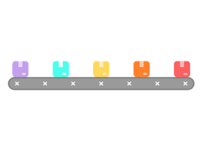
Using power of LLMs
LLM
Improved Project
Change Miner (ICSE-2022)
Example code changes
PyEvolve (ICSE-2023)
Notes:
This is our pipeline and now we augment it with large language models.
We input code change examples, and then use large language models to generate syntactic variants.
We use the generated variants to infer transformation rules.
These rules will enable transforming syntactic variants of a given code change.

Slide 32
RQ2). How effective are LLMs at generating test-cases?
LLMs excel in test case generation (up to 503) but also introduce errors (19%).
Notes:
The second reseach question is How effective are LLMs at generating test-cases?
To analyse LLM’s test cases generation capabilities,
We analysed test cases generated for 20 code change patterns.
We used the same three kinds of LLMs for this experiment as well, GPT3.5 GPT 4 and PALM
Our analysis shows that LLM can generated upto 503 test case per variations but 19% of them are erroneous.
It contains errors suh as formatting errors, syntax errors, and some even had uninitialized varaibles and seom tast cases had invalid assertions.
This large error rate would be unacceptable for to use inside code automation tools like IDEs.

Slide 33
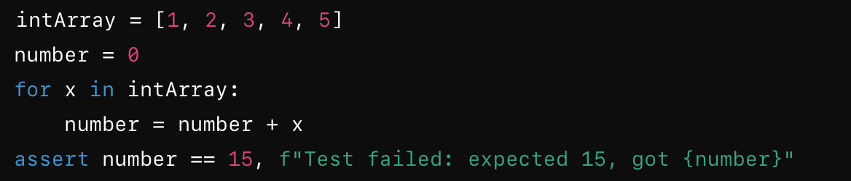
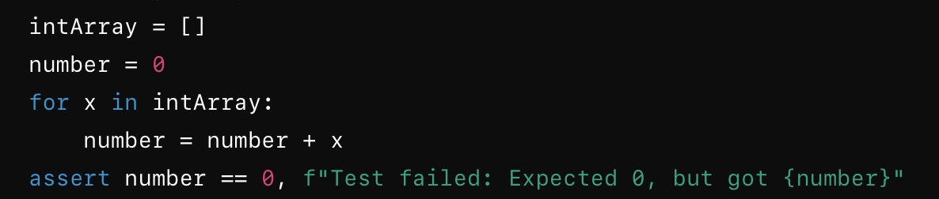
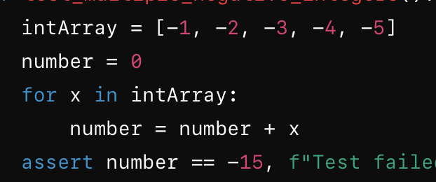
RQ2). How effective are LLMs at generating test-cases?
LLMs excel in test case generation (up to 503) but also introduce errors (19%).
Notes:
The second reseach question is How effective are LLMs at generating test-cases?
To analyse LLM’s test cases generation capabilities,
We analysed test cases generated for 20 code change patterns.
We used the same three kinds of LLMs for this experiment as well, GPT3.5 GPT 4 and PALM
Our analysis shows that LLM can generated upto 503 test case per variations but 19% of them are erroneous.
It contains errors suh as formatting errors, syntax errors, and some even had uninitialized varaibles and seom tast cases had invalid assertions.
This large error rate would be unacceptable for to use inside code automation tools like IDEs.

Slide 34
Evaluation
LLMs excel in generating unseen variants (584 per CPAT) but also produce errors (65%).
LLMs excel in test case generation (up to 503) but also introduce errors (19%).
Medium temperatures yield more realistic variants (Kruskal-Wallis test, Wilcoxon-signed-rank is used)
Our tool generated 86 code changes in 20 open-source projects, of which developers accepted 72 (83%)
Keras
20 highly rated ML projects

Slide 35
RQ3). What are the optimal parameters for generating unseen variants?
Continuing prompt iterations indefinitely is an option to generate numerous variants.
Beyond the third iteration, LLM produces new variants sparingly.
Notes:
The third research question is about the optimal parameters for generating variants.
We studied the number of times that we actually have to perform prompt iteration to generate the variants.
We selected 10 code change patterns and studied the variant generation along with prompt iteration up to 10.
We observed that beyond the third iteration, the CPATs do not produce a statistically significant number of new variants.
Even though we have the potential to reprompt each code change pattern indefinitely, it seems that we do not have to do it indefinitely to generate more variants, and doing it three times is enough.

Slide 36
RQ3). What are the optimal parameters for generating unseen variants?
Realistic variants
Temperature
Medium temperatures yield more realistic variants (Kruskal-Wallis test, Wilcoxon-signed-rank is used)
Notes:
We studied the generation of realistic variants along with the temperature values.
The temperature in a large language model adjusts the randomness of generated outputs, with higher temperatures yielding more diverse but potentially less focused responses, and lower temperatures producing more deterministic and focused results.
One major observation that we made was that temperatures with middle values, such as 0.4, 0.6, and 0.8, generate more realistic variants and are good for variant generation.
To enhance the realistic variants, we fine-tune the hyperparameters of the large language models. We utilize the LLM with middle-temperature values that are neither too random nor too deterministic, Here we aim more realistic variants.

Slide 37
RQ4). What are the optimal parameters for generating test cases?
Generated test cases for each <temperature, prompt iterations> (t,i) setting
Used generated test cases in each setting to detect correct variants and compute the F1 measure.
A higher temperature, set at 1.2, along with prompt iterations up to 7, contributes to the generation of more robust test cases.
Notes:
We use testcases to filter-out correct variants, that are semantically equal to the original CPAT.
Under this reseach question we want to study capabilities of test cases generated by LLM for each temprature and iteration setting.
We use 10 code change patterns for this experimenet.
For each code change pattern, we fist generate set of test cases for each temprature and iteration value and then use them to identify correct varianrts in an oracal, and then we compute F-1 measure.
We select the best temperature and iteration value for each CPAT considering the F-1 measure.
For example, X axis in this value grid basically represent the best setting for each CPAT,
for CPAT 1 temperature 1.2 and itration 7 achived the best results which is 100%
That means test cases generated for CPAT1 under temperature 1.2 and itration 7 is ablve to identify correct variarnts with 100% F1-measure.
Then we performed cross validation to make sure that settings that we learnt valid irrespective of the code change pattersn
We basically, take the each best setting and then generate test cases for all other Code change patterns and compute its F1-measure.
So the values in these other cells basically repretnt those values.
So we observed that irrepetcive of the code change patterns temperature 1.2 and iteration varies upto 7 has the best performance when generating test cases.

Slide 38
Prompt to Generate Variants
Your task is to provide different examples of writing the same block of python code delimited by triple backticks.
Your code can be better or worse than the original. Your code can be longer or shorter than the original. Provide multiple examples like a beginner, intermediate, and expert programmer.
Provide as many examples as possible. You are allowed to use in-built python functions.
Perform the task using the following steps:
1. Generate a variation of the original code, using the guidelines above.
2. Verify that the variable(s) take the same value in the original and your example at the end of the code.
3. Verify that any dependent libraries have been imported in the code
Format your response as JSON list. Each element of the list should be a string containing the code example.

Slide 39
Prompt to Generate Test-Cases
Your task is to provide test-cases for the python code-block delimited by triple backticks.
Provide edge-cases(like empty lists, empty string, strings with spaces, None, floats, float as a string, etc). Provide some cases in which the code must throw an error. Provide <=10 test-cases. Make sure that all variables used on the right-hand side of the program are initialized.
Here are the types of the variables in the code …
Respond with two components of the test case. a. Initialisation statements: Python code to initialise the variables(s) <RHS_VARS>. These must be valid python statements. b. Assertion statements: Python assertion statement(s) to validate the correctness of the code. In case the test case must throw an error, respond with the string "error" here. Format your response in JSON. Use the keys: "init", "assertions". Here is an example for how to perform your task: …

Slide 40

Questions for discussions
Which results or what parts of the technique you found most surprising?
Where do you need more details ?
Which parts are most valuable to what you are doing at NEC?
What else are we missing?
Notes:
We would like to engage in an interactive discussion after the talk. We hope that this discussion will aid us in generating new ideas and also help us understand the feasibility of integrating the solution into IDEs.
We carefully design these questions, and it will help the guide the discussion.
I will present the questions before the presentation so that it will help you to think about the questions while I am presenting.

